Slide 1


Method
For all your major company initiatives
helps to speed up company initiatives (strategies, concepts...) and makes them happen!

Slide 2
What it‘s all about
The BigStep® Method helps to speed up initiatives (strategies, concepts...) and makes them happen!
BigStep® has 3 Phases
Screening
  Raising awareness of the main issues related to the problem/initiative in your team (creates group consciousness)
BigStep® Workshop ....
  Focuses, motivates, and aligns your Team on an initiative (concepts, strategies, .....) in one Workshop
BigStep® Engine
  Makes things happen. Speeds up Execution (guaranteed Execution rate of ~ 90% of measures and projects within 12 months)

Slide 3

The Problem: Poor Execution Rate of Projects!
Research Study shows the satisfaction of the German Top Management with Project Management in Organizations
See Gröger, Projektmanagement: Abenteuer Wertvernichtung, 2004, n=962 in Germany

Slide 4
Why projects fail*?
* See Heines, Ergebnisse der Studie: Projekte als Erfolgsfaktor, 2011

Slide 5

The problem of many organizations!
Strategies and Concepts developed by the Top-Management Team are not implemented throughout the organization.
many ideas
many concepts
many action plans
poor implementation
poor results
Action plans of small project teams don’t have the commitment of the Top Management and fail.

Slide 6

Why many Initiatives fail
Deeper understanding in the organization is missing.
Critical mass is not reached.
No commitment – no buy-in
The expertise of the employees is not retrieved.
The improvement process is applied incorrectly.
A sustainable implementation process, starting with the selection of the right projects and ending with a successful completion of the projects, is missing.

Slide 7
  No matter if you plan a Cost Reduction Program, Productivity Increases or a massive Sales Initiative:
  With BigStep® you save a lot of time, because your team will be aligned
  in just one workshop

Slide 8
With the BigStep® Engine you achieve an execution rate of ~ 90% of your projects and measures within 12 months, because you follow a proven implementation process.

Slide 9
The BigStep® Method
BigStep® is
a team and role based, non-hierarchical method
a bottom up method (vs. top down)
a large group intervention workshop for up to 40 people
a motivational workshop
an intelligent problem-solving-process
BigStep® Benefits
Makes your team buy in, into your initiative in one Workshop
Increases efficiency and effectiveness of your initiatives
Unleashes the know how of all people involved
You will arrive at an execution quotient of measures/projects of ~ 90% within 12 months (vs. German Industry standard ~ 35%)

Slide 10
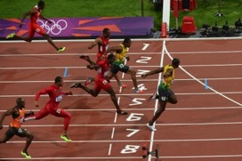
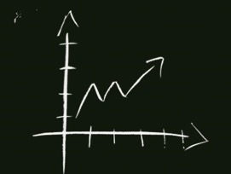

Most important applications of BigStep®
Competitiveness
Productivity Improvements and Cost Reduction
Utilization of Synergies
Growth
Implementation of Growth Strategies
Organic Growth and Acquisitions
Organization and Processes
Change and Repositioning
Reorganization and Communication
Post Merger Integration

Slide 11
The Procedure of BigStep®
Before BigStep®
Screening (Facts & Figures and Interviews with Key Players)
Definition of „Opening Question“
Selection of Participants
During BigStep®
Key Topic Selection by Participants (Definition of the Key Topics )
Key Topic Assignment
Session 1
Analysis: Creating common understanding
Session 2
Defining: Objectives
Session 3
Solutions: Action and Project Plans
After BigStep®
Follow Up Action Plans, Projects, From Actions to Results!

Slide 12
Examples of Opening Questions
Before BigStep®
  „How can we achieve a cost reduction of € 2 M. in 20xx?“
  „How do we have to adapt and develop our organization in order to stay competitive?“
  „What do we have to do to achieve an increase in market share by 5% till the end of next year?“
  „What are our main projects we have to focus on in order to achieve our strategic targets till 2020?“
  „How can we improve our internal communication and teamwork?“
  „What do we have to do, to achieve a high effectiveness and efficiency of our R&D projects?“
  „What do we have to do in order to increase the speed of our order fulfillment process dramatically?
Definition of Opening Question

Slide 13
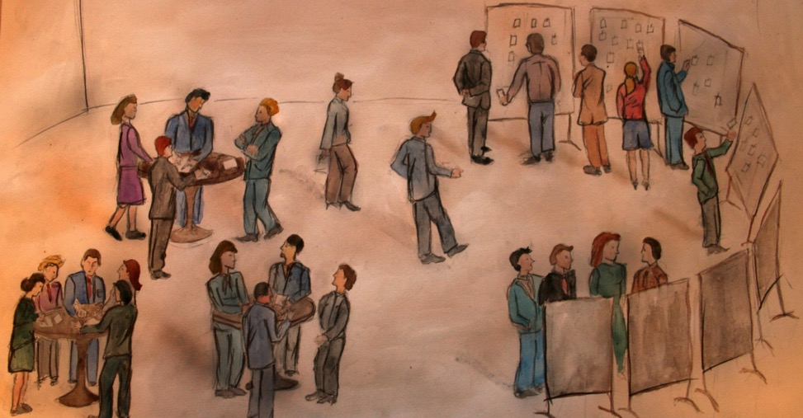
The Procedure of BigStep® - Key Topic Selection
  Explanation of roles, rules and method
  Opening statement und key question by the executive (in/out topics)
  Brainstorming, workshop cards and clustering
  Key topic selection
  Definition of Teams following a mathematical algorithm
During BigStep®
Key Topic Selection
(Definition of Key Topics)

Slide 14
Workshop – Time Table
Example – 6 Key Topics
During BigStep®
Session 1:
Analysis
Session 2:
Objectives
Key Topic Processing
Session 1
Session 2
Session 3
Session 2:
Objectives
Session 3: Solutions

Slide 15
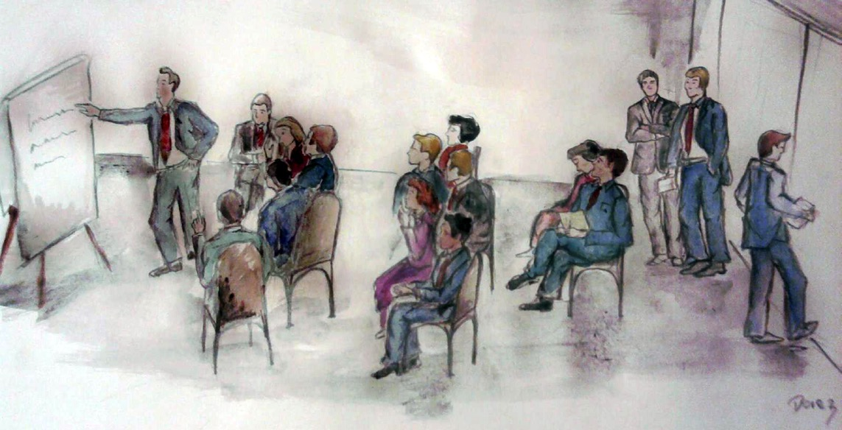
The Procedure of BigStep® - The Roles
Moderator: Leads the discussion
Debaters: Solve the problem
During BigStep®
Key Topic Selection
Session 1 (Analysis)
Session 2
(Objectives)
Session 3 (Solutions, Projects & Actions)
Critics: Feedback
concerning flow and content of discussion
Observers: Cross link information

Slide 16
No. of Sessions and Information Dissemination
  The specific workshop-design of BigStep® leads to an almost homogeneous information distribution (~90%) amongst all workshop participants in three sessions
During BigStep®
Key Topic Processing
Session 1 (Analysis)
Session 2
(Objectives)
Session 3 (Solutions, Projects & Actions)
Percentage of homogeneous information distribution
Source: Stafford Beer, Beyond Dispute,
Applying Cybernetic Science to organizational Problems

Slide 17
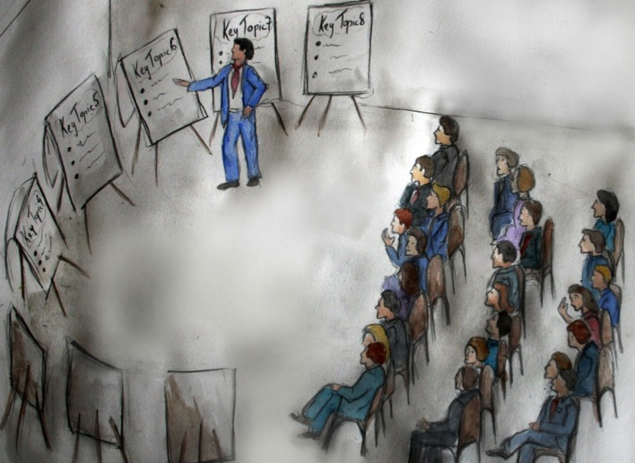
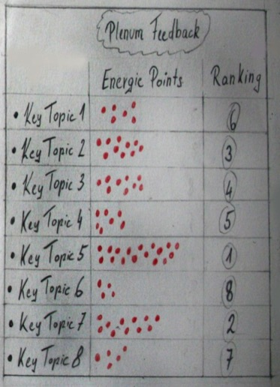
The Procedure of BigStep® - Plenary Feedback
During BigStep®
  In five minutes time, each group presents results of their session.
  The results are ranked by the participants. (Energy Points Award)
Plenary Feedback and Energy Points
After each Session

Slide 18
Results of the BigStep® Workshop - Example
  Quick Wins (within 3 months)
    Reduction of Setup Time with 4 Step Rapid Setup Method
    Introduction of freight fee for small quantities orders
    Implementation of „OK-Point“ in the order fulfillment process
    Rework documentation
    Spring Cleaning / „Red Card“ Measures
  Break-through Projects (3 to 6 months)
    Market Entry in new Market Segment
    Reduction of Material Costs
    Utilization of employees
    Reduction of Cost of poor quality
    Optimize Product Portfolio
  Projects and Measure (3 to 9 months)
    Improvement of communication
    Improvement of Accounts Receivable Management
    Implementation of reusable containers
After BigStep®
Implemen-tation of
Multi -
Project - Management
BigStep® Implementation Engine

Slide 19
Savely implement projects with BigStep®
„10 months after the BigStep® Workshop the execution rate of the agreed projects is 85%!“
DI Thomas Fenzl, CEO Miba Sinter
BigStep® Screening
  Facts & Figures
  Qualitative Interviews with selected Key Players
  Presentation of Results
  Purpose: Raising awareness of the main issues related to the problem/initiative (creates group consciousness)
BigStep® Workshop (2 to 3,5 days)
  Executive Summary of Screening
  6/8/12 Key Topics
  24 – 50 Participants, 4 Moderators (for smaller groups: 2 Moderators)
  Purpose: Focusses, aligns, motivates the Team around the initiative (concepts, strategies, .....) in one Workshop!
BigStep® Engine
  Prioritization of Projects
  Implementation of Multi – Project – Management
  Immediate realization of Quick Wins and Break-through Projects
  Makes things happen, speeds up Execution (Execution rate ~ 90% of measures and projects)

Slide 20
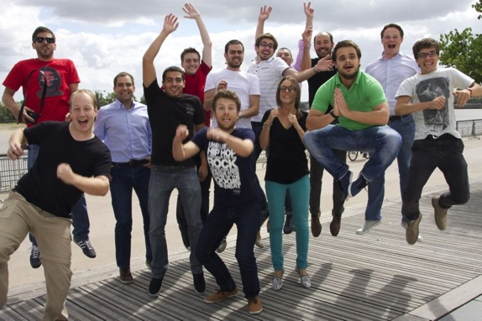

The Results of BigStep®….
BigStep® Method helps to speed up initiatives (strategies, concepts, ...) and makes them happen!
Team is within 2 – 3 days fully committed to a strategic initiative, a specific program or a change issue.
Prepares the team for the implementation
Motivation Workshop, creates Momentum
in the team
Guarantees the implementation with the
„BigStep® Implementation Engine“ in
the next step
Immediate realization of “Quick Wins”
Break-through Projects guarantee the
sustainability of the improvement
measures.
Are you ready for your next
?

Slide 21
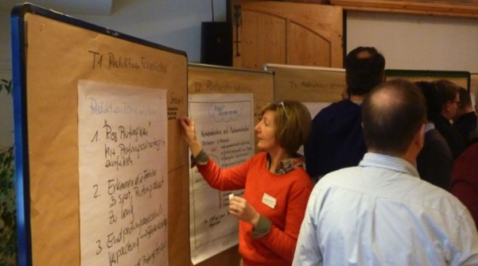
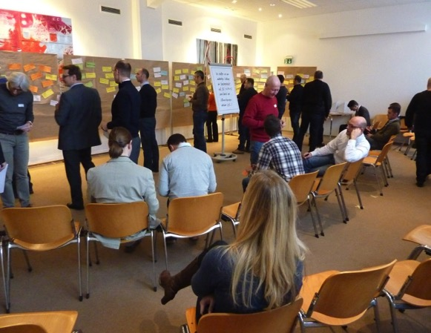
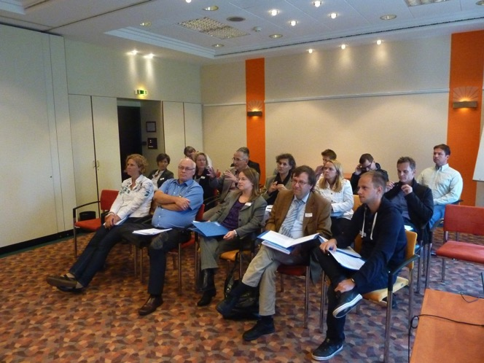
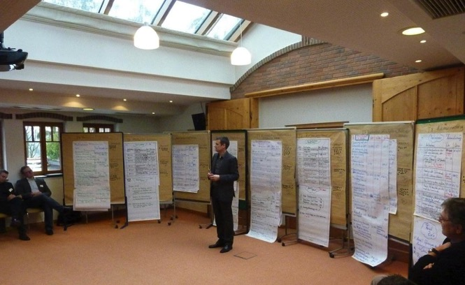
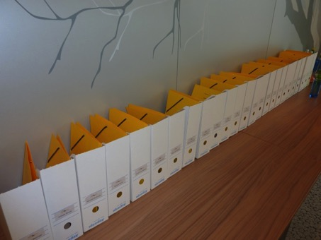
Impressions of BigStep®
Observer
(in third row)
Debaters
(in first row)
Critics
(in second row)

Slide 22
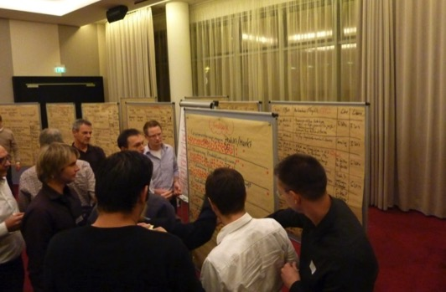
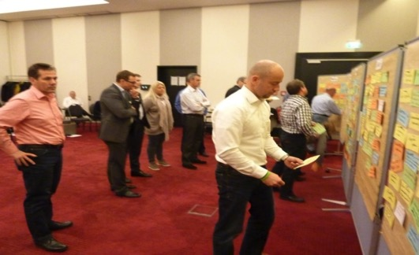
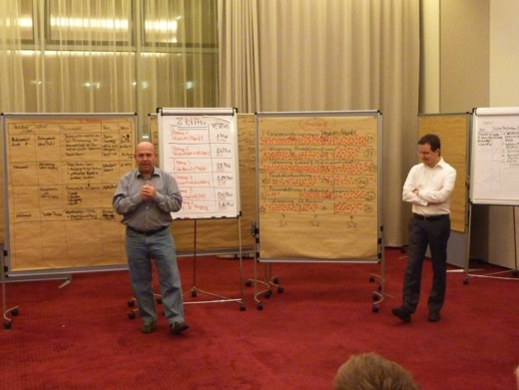
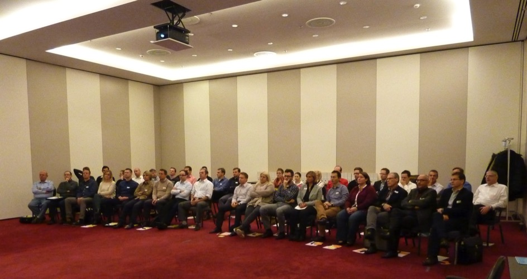
Impressions of BigStep®

Slide 23









These companies already rely on BigStep®
Feb 2012
Jan 2012
Jan 2015
Jan 2015
Jul 2014
Sep 2014
Jan 2013 Apr 2014
Nov 2013
Nov. 2014
May 2015
Sept 2015
Apr 2013
Oct 2014
Sep 2012
Mar 2014

